Slide 1
Lvl 4/5 Group Project Group 7
Elliot Page, Michael Curtis, Thomas Barrett, Anastazia Hunt

Slide 2
Lexicon
Demographic – Females Aged 18-24
Platform – Mobile

Slide 3
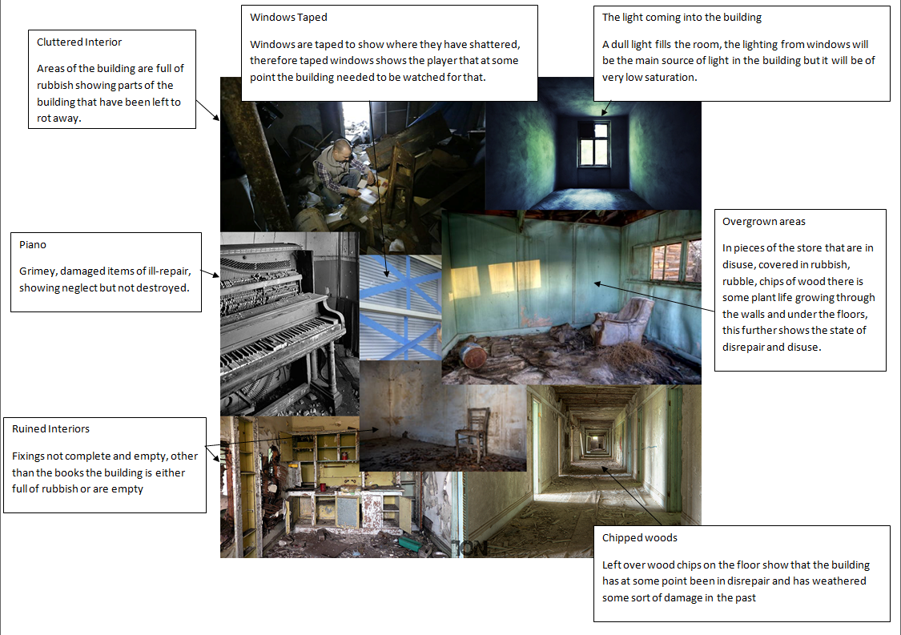
Vellichor

Slide 4





Vellichor

Slide 5
Adronitis
Player does well when they know the characters
Players don’t do well initially
Frustration

Slide 6
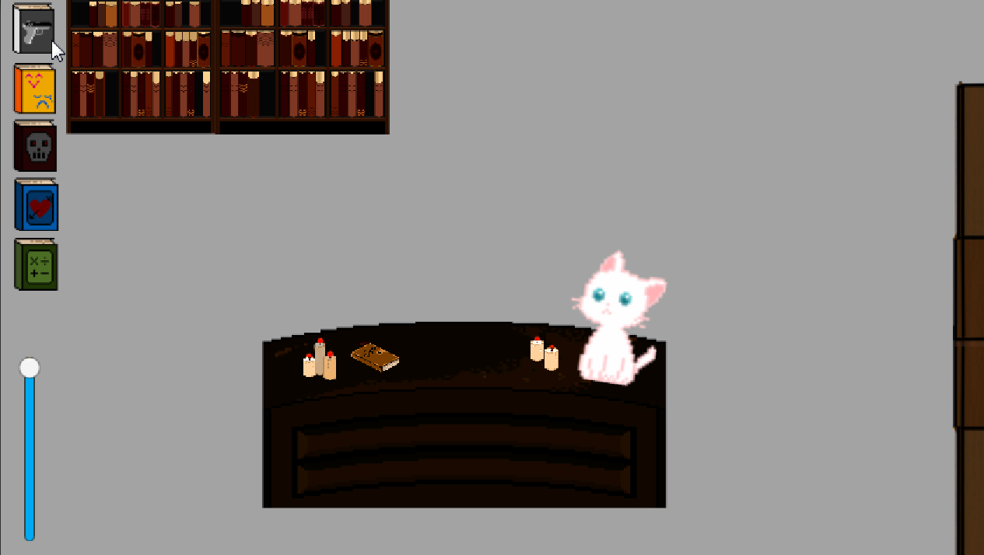
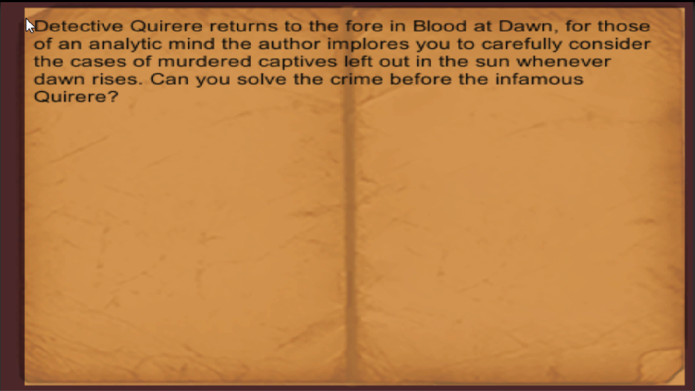
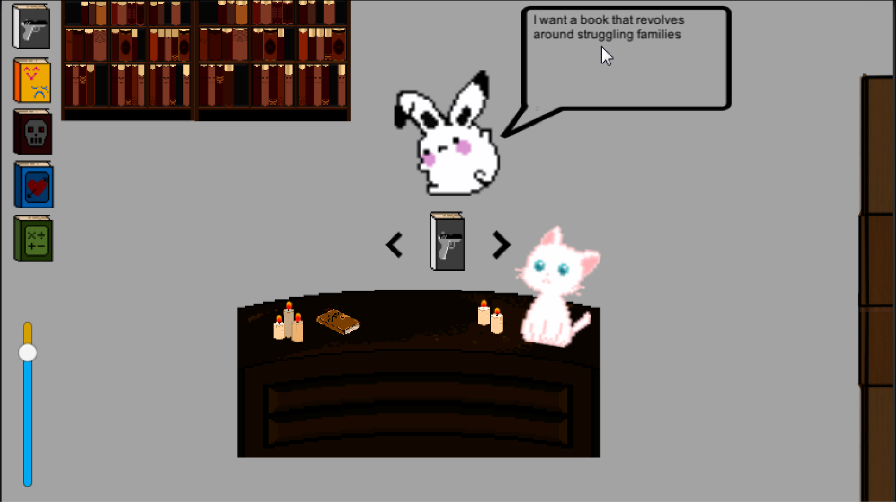
Adronitis

Slide 7
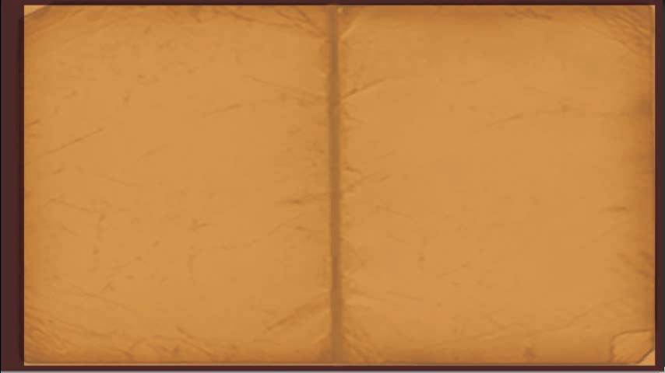
Gameplay

Slide 8
Hours Worked
Elliot : 33(39) Hours
Michael : 33 Hours
Anastazia : 45 Hours *
Thomas : 19 Hours

Slide 9
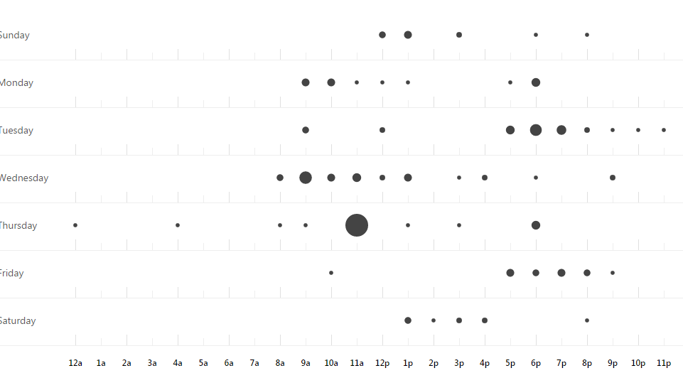
Project Management

Slide 10
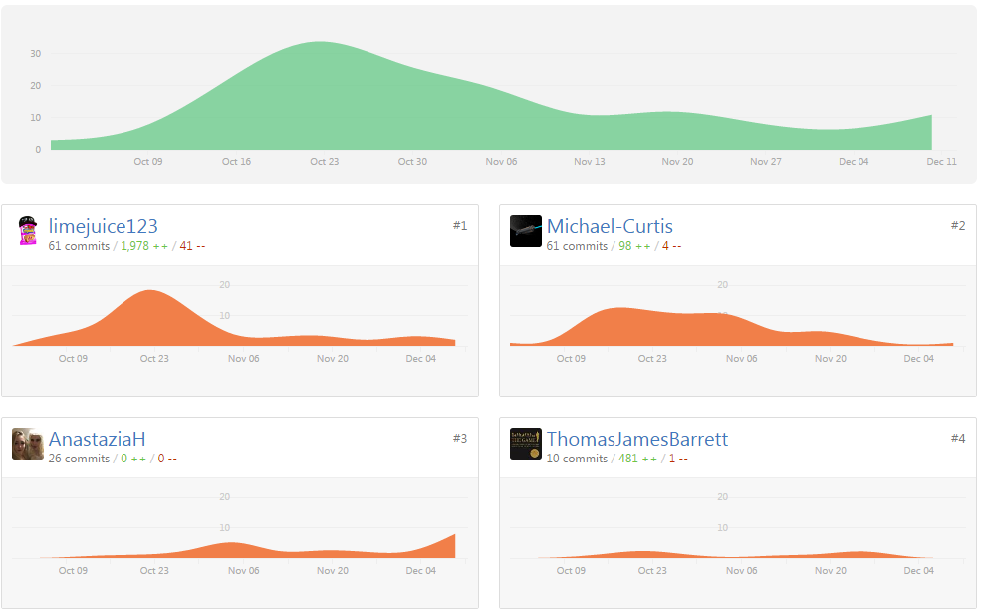
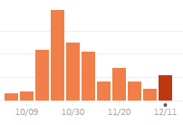
Project Management

Slide 11
Lessons Learnt
Communicating about task completion mid week rather than at the beginnings and ends of sprints.
Explore every element of our game design fully before beginning production. (External Logic)

